Slide 1
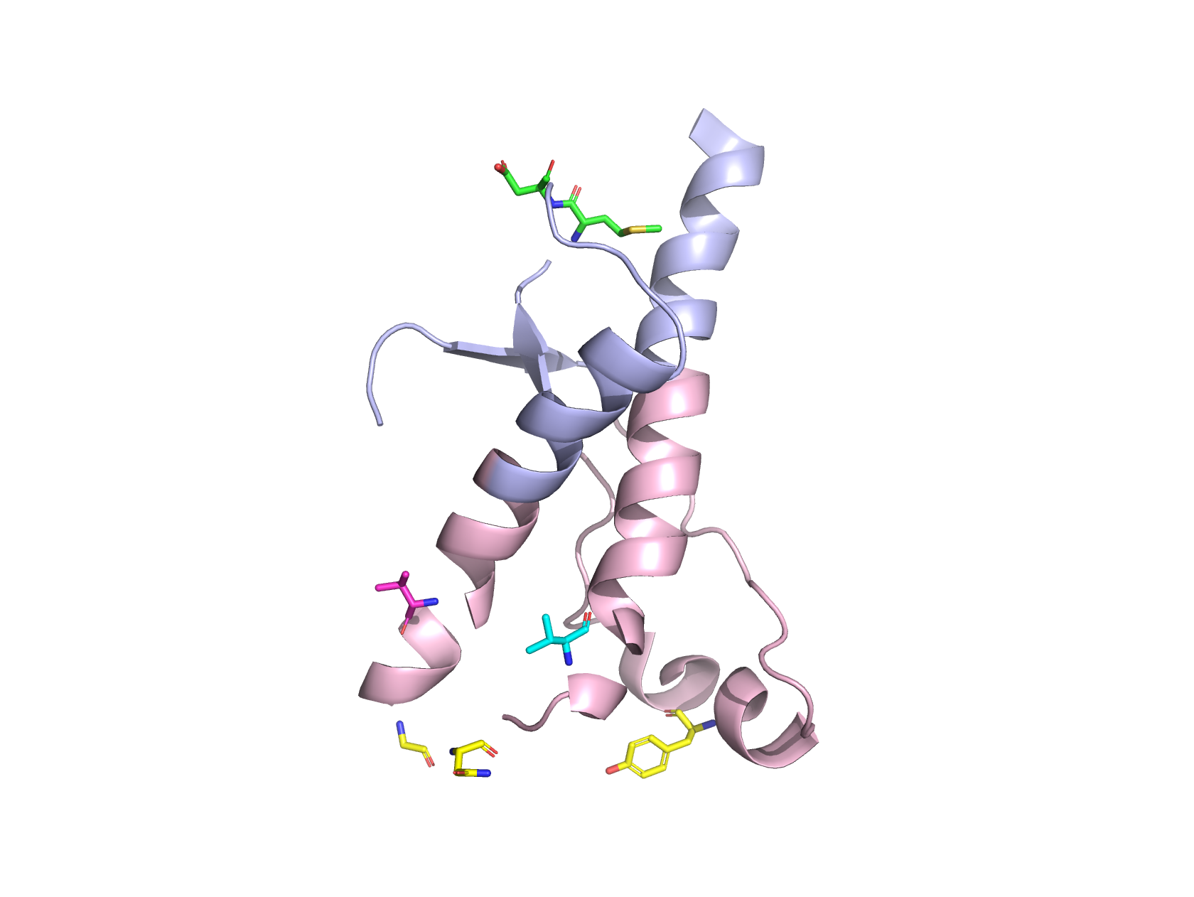
Computational analysis of human prion protein: Discovery of potential drug binding sites
Reagan McNeill Womack
Notes:
My research focused on using computer models and simulations to identify potential drug binding sites on human prion protein
These sites could be targeted by drug molecules to prevent the progression of prion diseases or transmission of prion diseases.

Slide 2
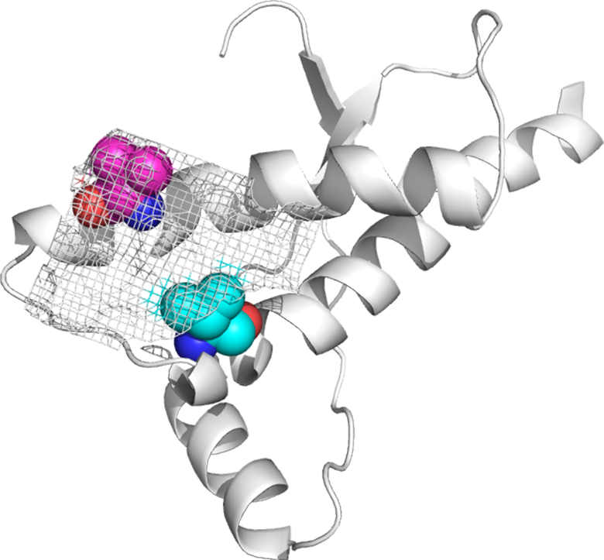
Agenda
Background
Computational Methods
Data and Results
Discussion
Next Steps

Slide 3
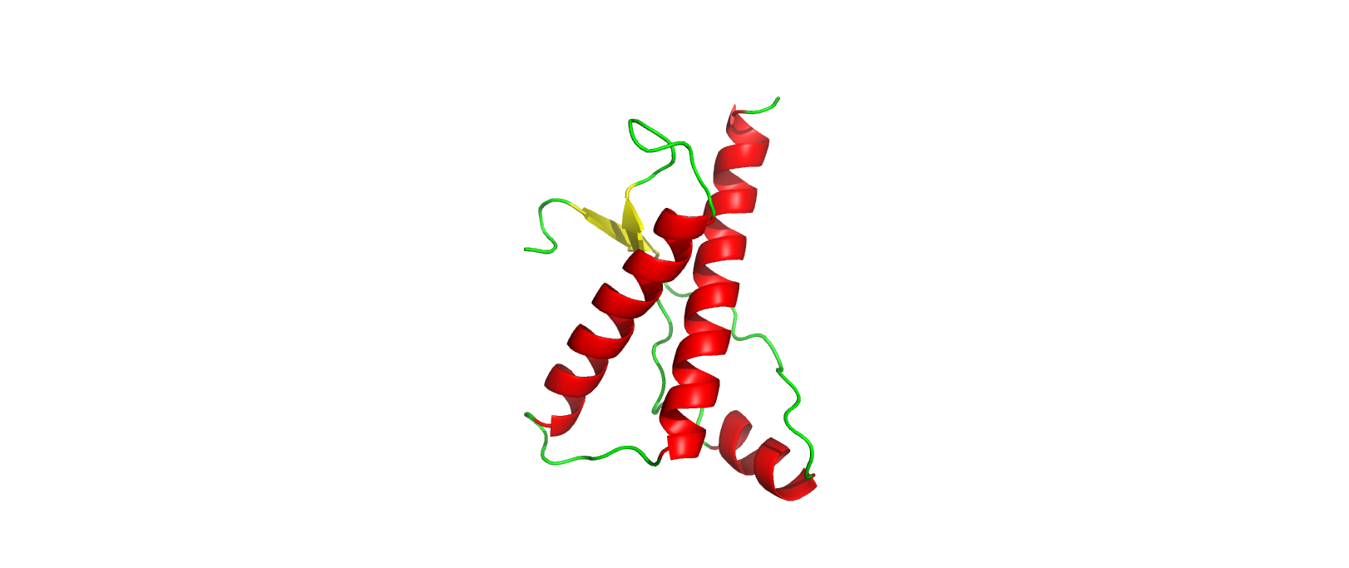
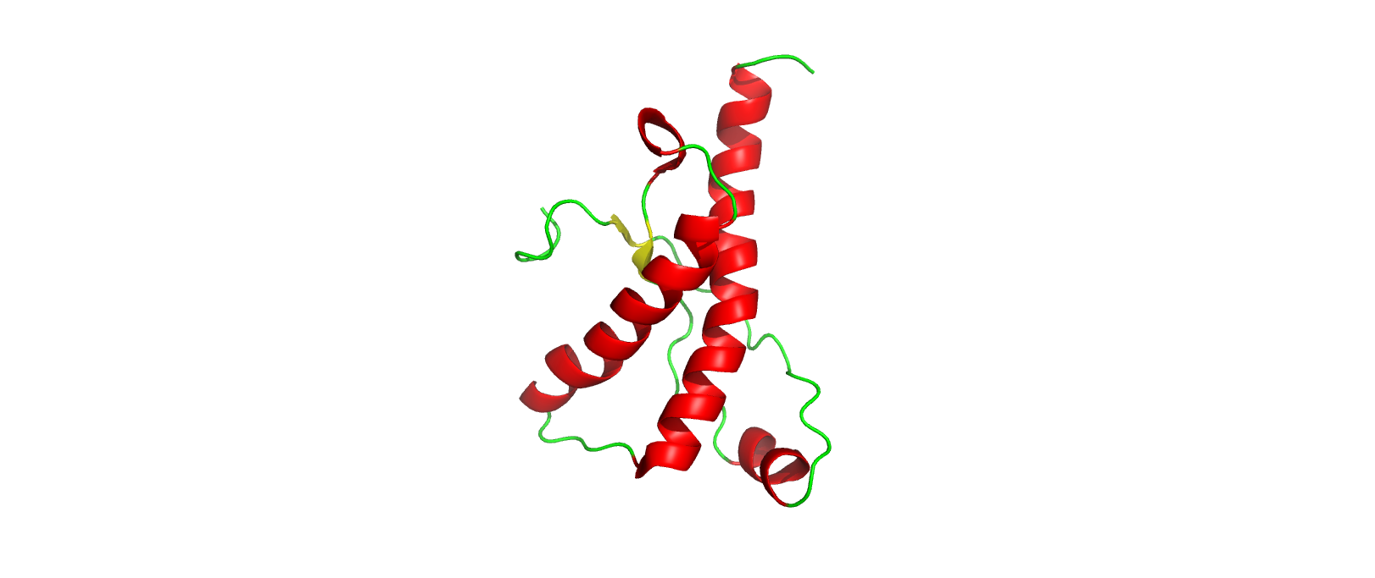
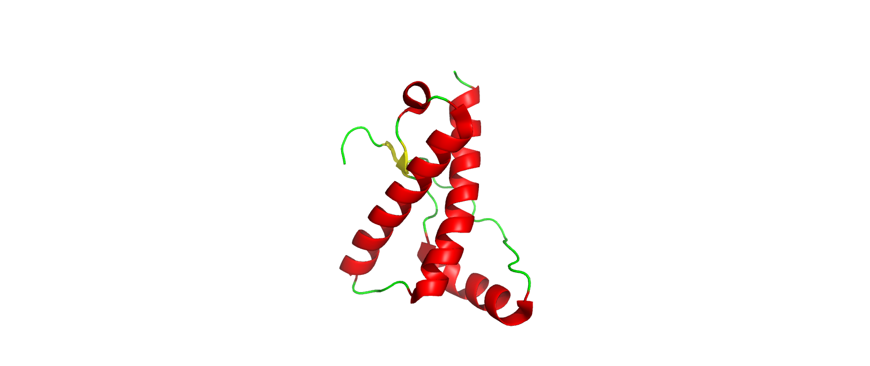
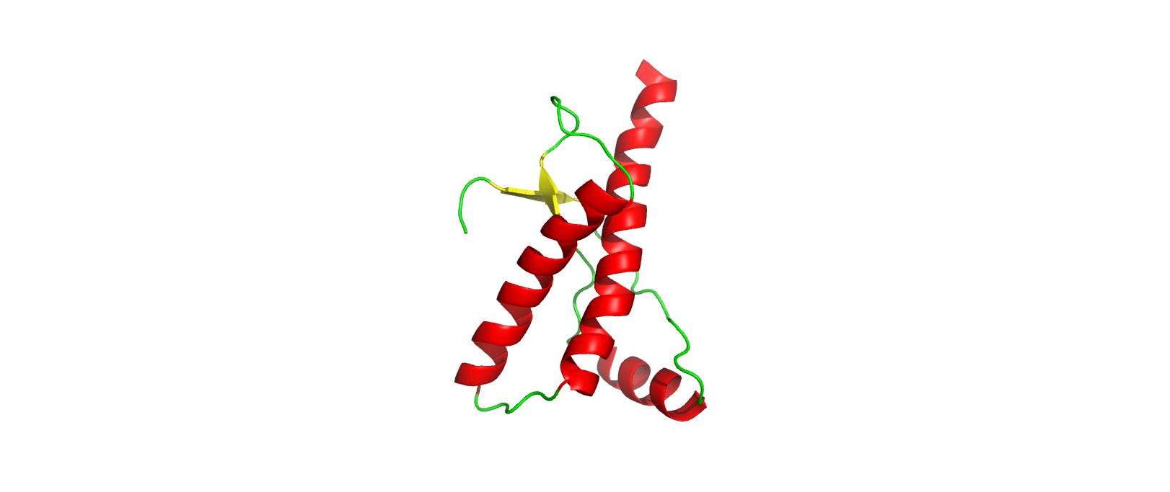
Prions and Prion Diseases
Mad Cow Disease (Bovine)
Scrapie (Ovine)
Chronic Wasting Disease (Cervid)
Creutzfeldt-Jakob Disease (Human)
Notes:
Prion diseases are a class of neurodegenerative diseases characterized by rapid and fatal disease progression
More common prion diseases: Mad cow, scrapie, chronic wasting disease
In humans: Creutzfeldt-Jakob disease
These are all different structures of prion protein, very little variation among them, studying one can lead to conclusions about all

Slide 4
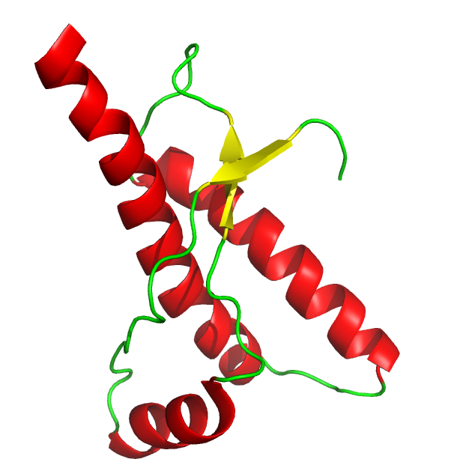
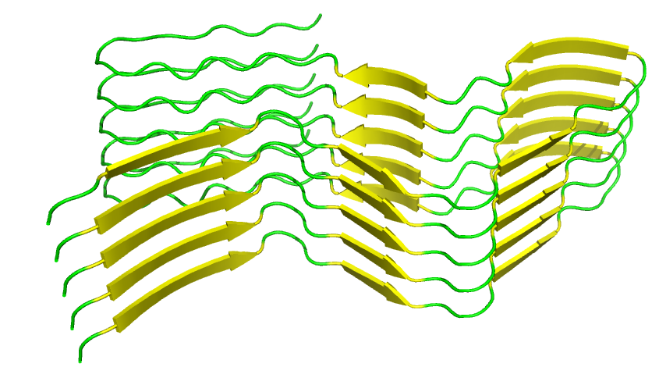
Prion protein isoforms form infectious amyloid fibrils
Notes:
Normal structure of prion protein consists of 3 alpha helices and 2 small beta sheets
When there is a mutation on PRNP gene encoding prion protein, structure might prefer to fold into beta-sheet rich conformation instead of normal conformation

Slide 5
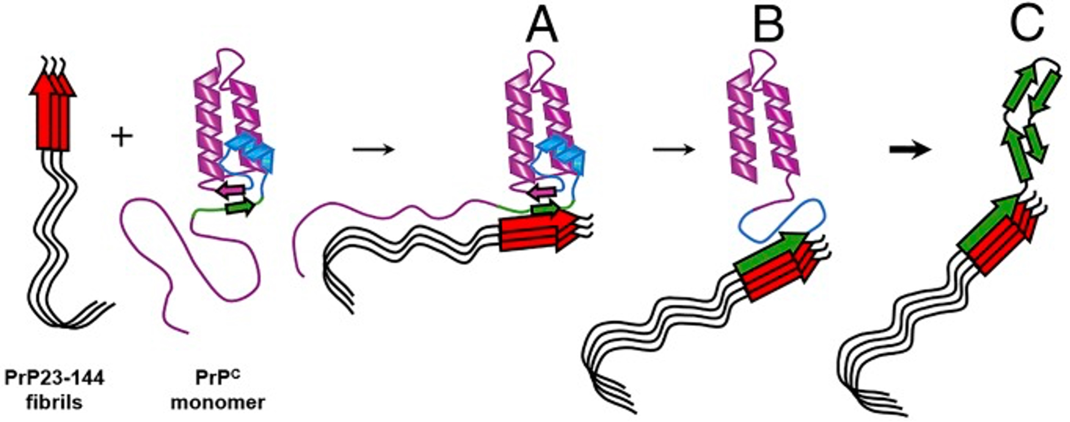
Prions are Infectious
Choi, J., Cali, I., Surewicz, K., Kong, Q., Gambetti, P., & Surewicz, W. K. (2016). Amyloid fibrils from the N-terminal prion protein fragment are infectious. Proceedings of the National Academy of Sciences - PNAS, 113(48), 13851-13856. https://doi.org/10.1073/pnas.1610716113
Notes:
Current working theory for how prion diseases progress
Abnormal prion attaches to normal prion protein and adds it to growing amyloid fibril
Amyloid fibrils very rigid and hard to break up, making early intervention crucial

Slide 6
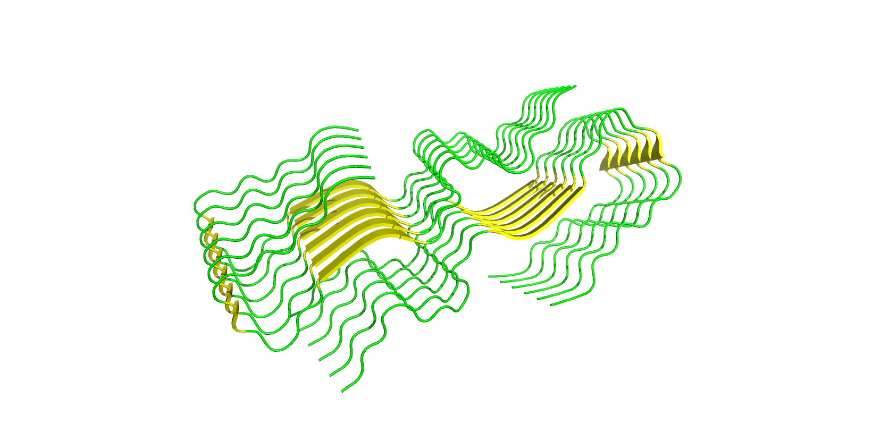
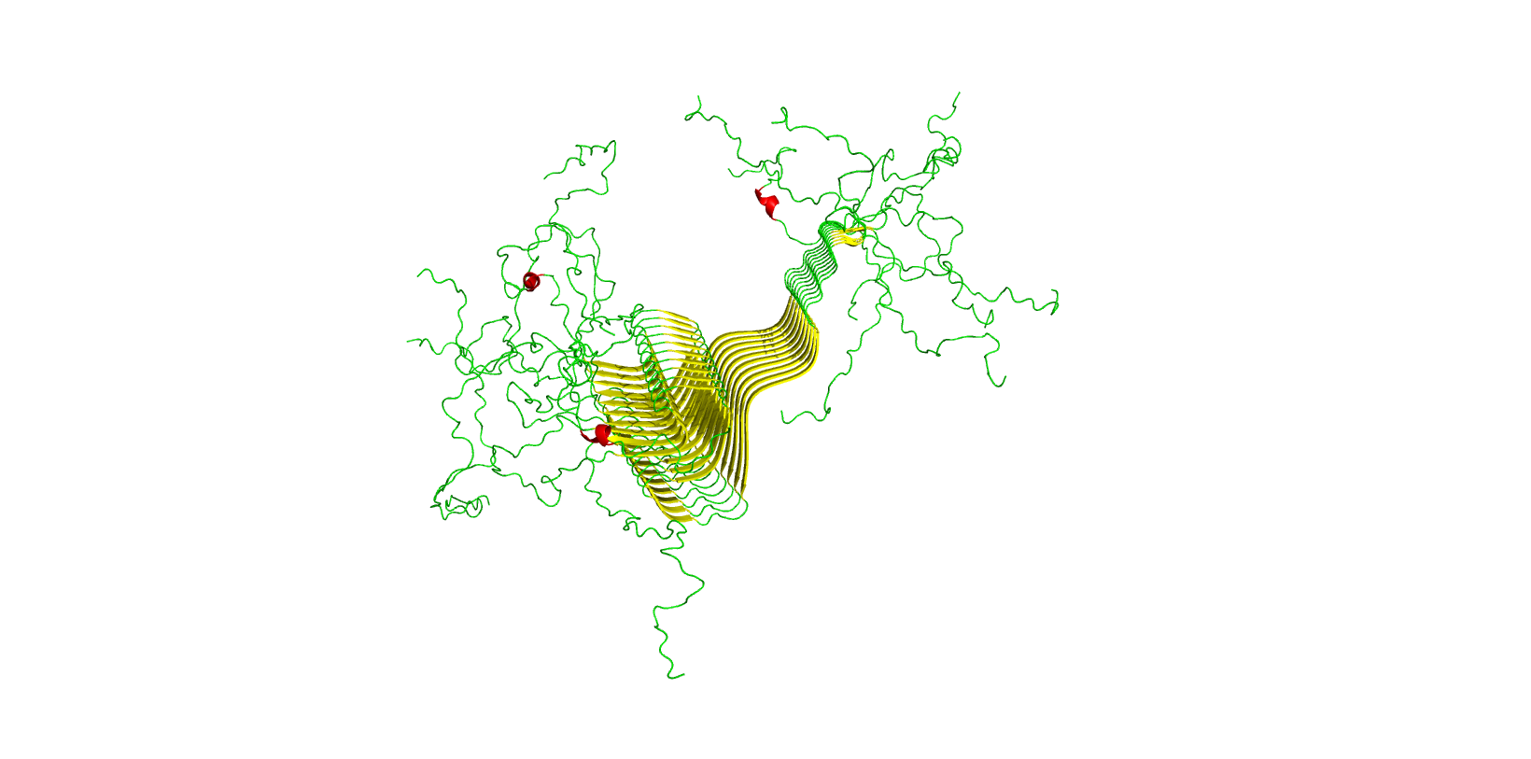
Other diseases show prion-like pathogenesis
Alzheimer’s Disease (amyloid-β peptide)
Parkinson’s Disease (α-synuclein)
Notes:
Prion diseases aren’t the only diseases that are caused by these growing amyloid
fibrils
Alzheimer’s & amyloid-beta peptide
Parkinson’s & alpha-synuclein

Slide 7
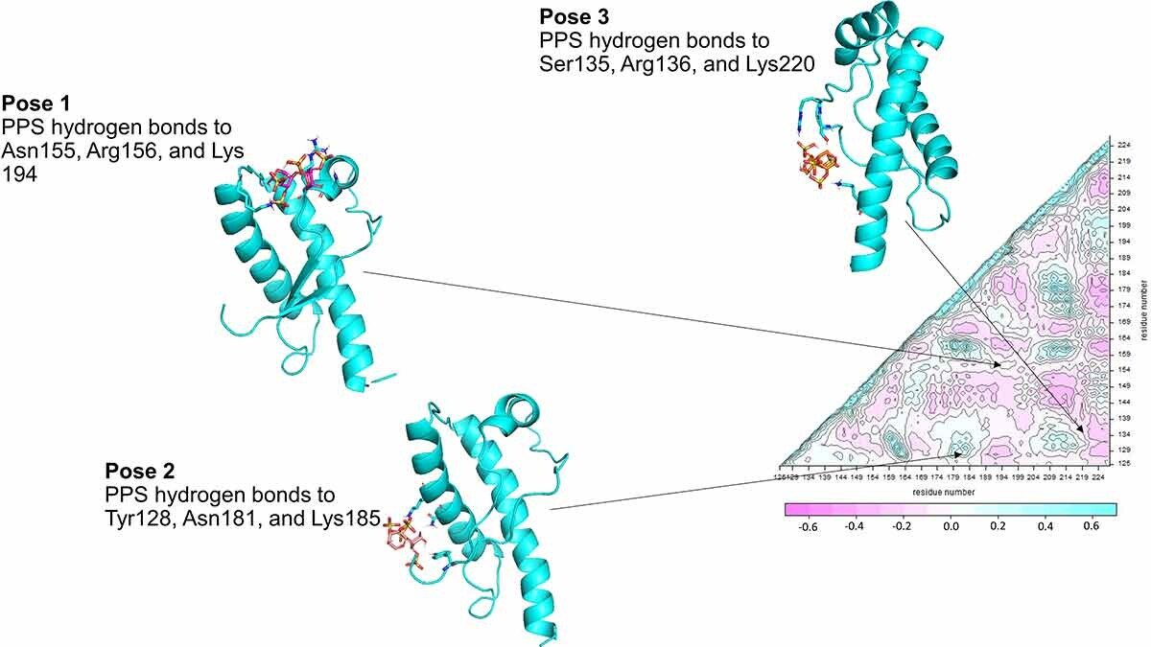
Pharmacological chaperones assist in protein folding
Soto, P., Gloeb, G. M., Tsuchida, K. A., Charles, A. A., Greenwood, N. M., & Hendrickson, H. (2023). Insight into the conserved structural dynamics of the C-terminus of mammal PrPC identifies structural core and possible structural role of pharmacological chaperones. Prion, 17(1), 55-66.
Notes:
Pharmacological chaperones bind to a polypeptide to assist in its initial folding to the native conformation
One previous study found three binding poses for pentosan polysulfate (PPS) on hamster prion protein in which it acted as a pharmacological chaperone
This study also uncovered information about the structure of prion protein that helped guide my research

Slide 8
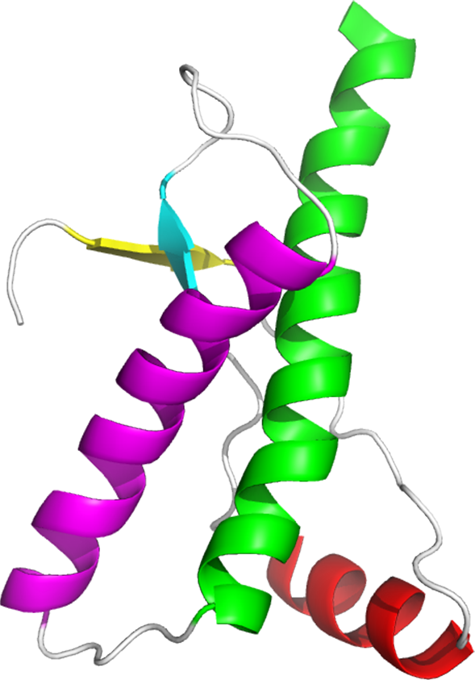
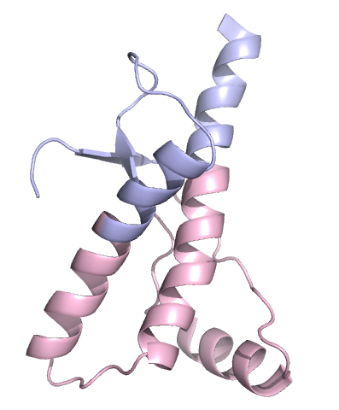
The structure of PrP^{C} provides insight into regulation
Non-conserved α2-α3 loop is proposed to be the site at which misfolding begins
PrP^{C} can be divided into 2 subdomains, separated by disulfide bridge connecting α2 and α3
Notes:
Alpha2-alpha3 loop area where misfolding starts, then spreads to rest of protein
Prion protein can also be divided into 2 subdomains
Lower subdomain where many infectious mutations are located

Slide 9

Research Focus
Predict potential regulatory sites using known models of allostery
Notes:
The focus of this research was to use known models of allostery and predicted effects of pharmacological chaperones to predict potential regulatory sites that may prevent misfolding of human prion protein

Slide 10
Agenda
Background
Computational Methods
Data and Results
Discussion
Next Steps

Slide 11
The process
Identify mutations of interest
Locate potential regulatory sites for mutations of interest
Test potential regulatory sites
Analyze results
Notes:
As previously mentioned, all methods used were computational and utilized free webservers and software. This makes my work easy to replicate with not only prion protein, but other proteins
The first step in my research was to identify a mutation or mutations that I wanted to focus my attention on
Next, I needed to locate sites on prion protein that are highly connected to the mutation sites, giving it the potential to regulate folding
Finally, I tested these potential regulatory sites and used statistical methods to analyze and validate my results

Slide 12
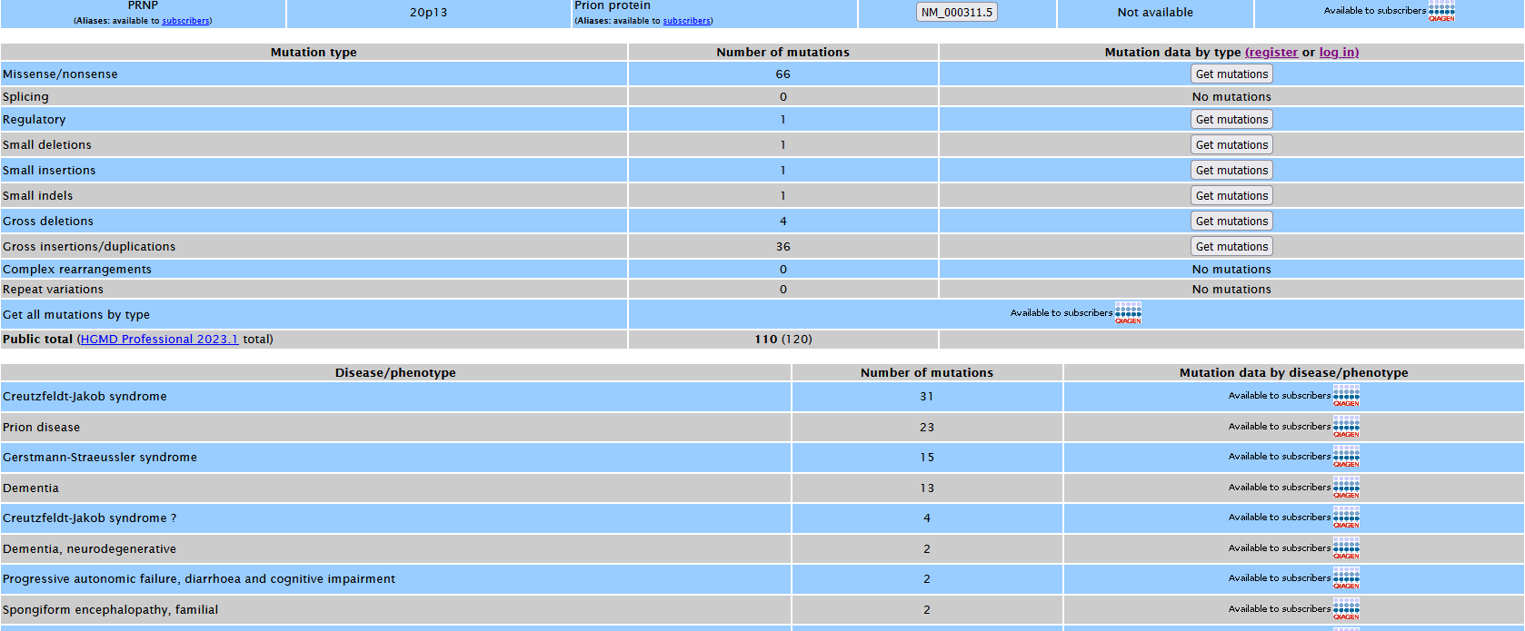
Identifying Infectious Mutations (HGMD)
Notes:
The human gene mutation database (HGMD) lists all known missense and nonsense mutations to the PRNP gene. This was used to classify each possible point mutation on prion protein as either “infectious” or “unknown”

Slide 13
Construction of Atomistic Graph
Read PDB file
Add atomic properties
Add bonds
Interpret quantitative variables
Perform calculations
Notes:
Each algorithm has its own method of translating a protein structure into something a computer can interpret, but they all follow a similar process
PDB file containing coordinates of every atom in protein structure is read
Atom size and other atomic properties (electronegativity, number of valence electrons, role in protein, etc.) are represented by numerical values that can be used to recreate mesh-like structure of protein
Bonds between atoms are represented by a numerical value, this value could link to particular properties for each bond or could be a quantitative measure of bond properties
Quantitative variables calculated are used to score each residue in different ways
Calculations can be performed now that each residue can be represented by different numerical values

Slide 14
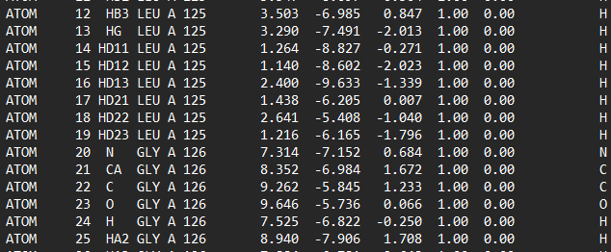
Atom Coordinates
Notes:
PDB file containing coordinates of every atom in protein structure is read

Slide 15
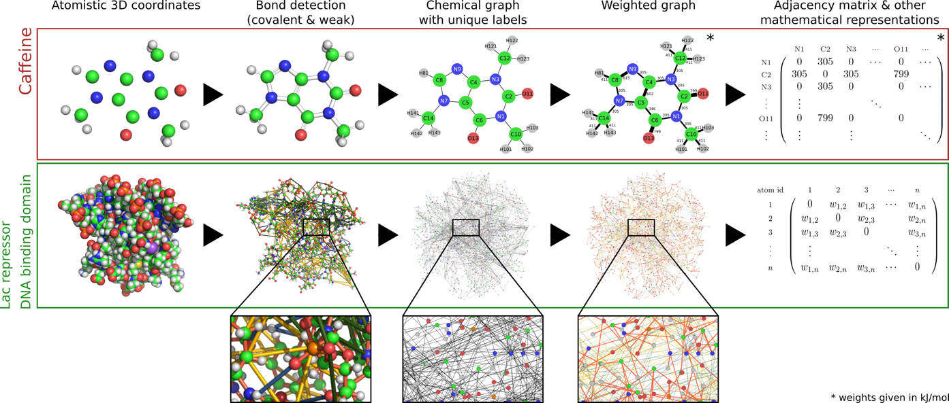
Schematic Overview of Graph Construction Pipeline
Background. (n.d.), ProteinLens. https://www.proteinlens.io/webserver/background.
Notes:
This is an overview of how proteinlens creates an atomistic graph of a protein to measure long-range communication within a protein

Slide 16
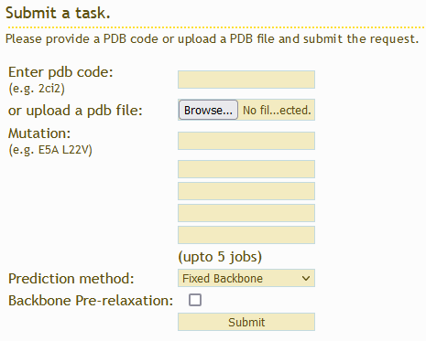
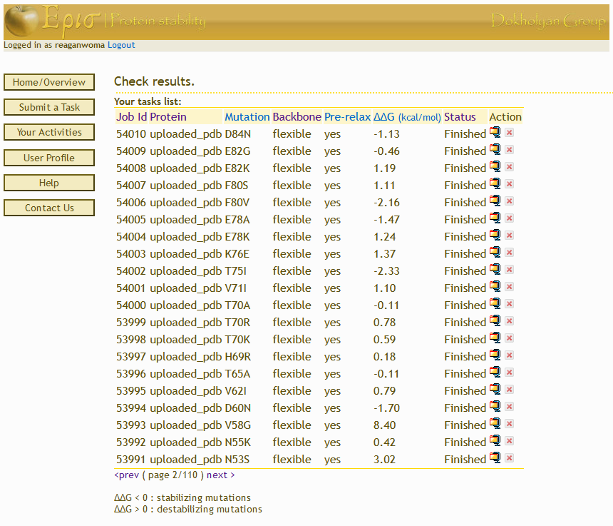
Identifying mutations of interest (Eris Suite)
Notes:
Once I had a list of all possible point mutations and whether they had been linked to disease, I used the Eris Suite webserver to predict the change in protein stability from an induced mutation
I was able to replicate the distribution seen in a previous study with 1I4M
Single-factor ANOVA performed to compare ddG distributions between two PrP models, no significant difference
Single-factor ANOVA performed to compare ddG distributions between jobs submitted with varying prediction parameters, no significant difference

Slide 17
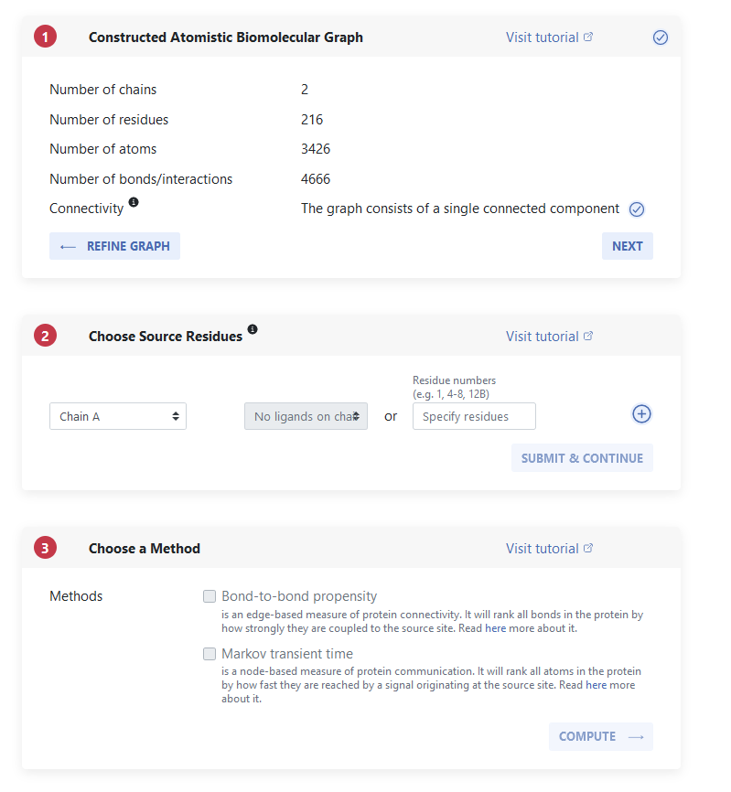
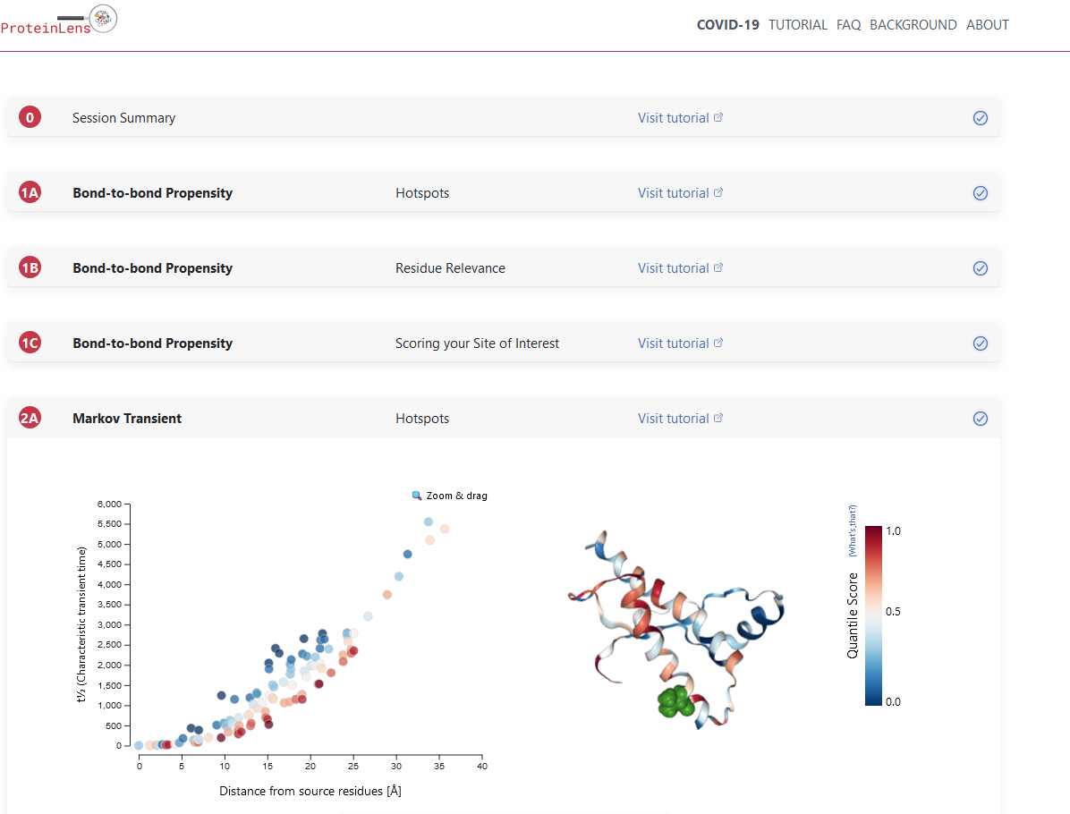
Locating Regulatory sites (ProteinLens)
Notes:
To identify potential drug binding sites, Markov Transient plots were generated using ProteinLens with respect to each of the target residues.
Characteristic Transient Time (t1/2) can be used to quantify how well a signal travels from one site on the protein to the source site, which was designated as one of the mutation sites of interest

Slide 18
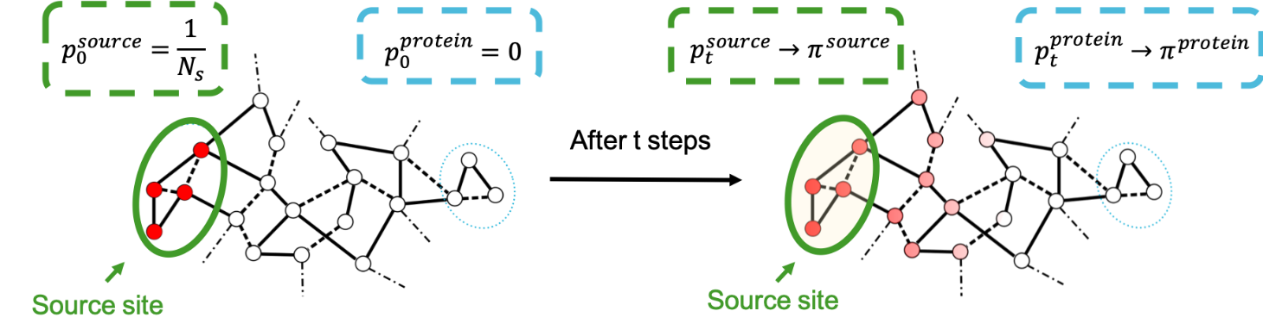
Markov-Transient Analysis
Background: Markov Transient Times. (n.d.), ProteinLens. https://www.proteinlens.io/webserver/background.
Notes:
Residues directly adjacent to the mutation sites (V189 and V203) will have strong connection to mutation site
Residues located further away from mutation site can also have strong connection
Markov Transient Time measures a theoretical length of time it takes for a signal from one residue to reach a designated source site
ProteinLens allows the calculation to be automatically determined for all residues in a single protein

Slide 19
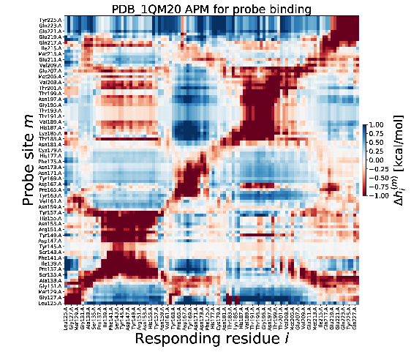
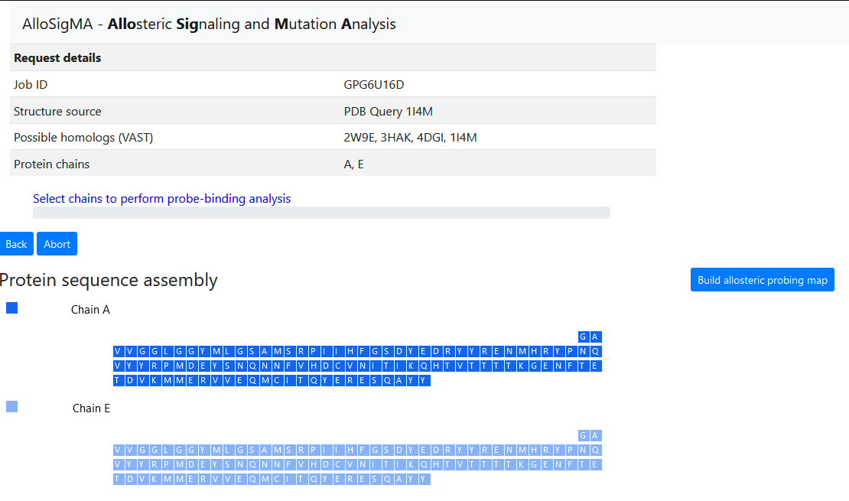
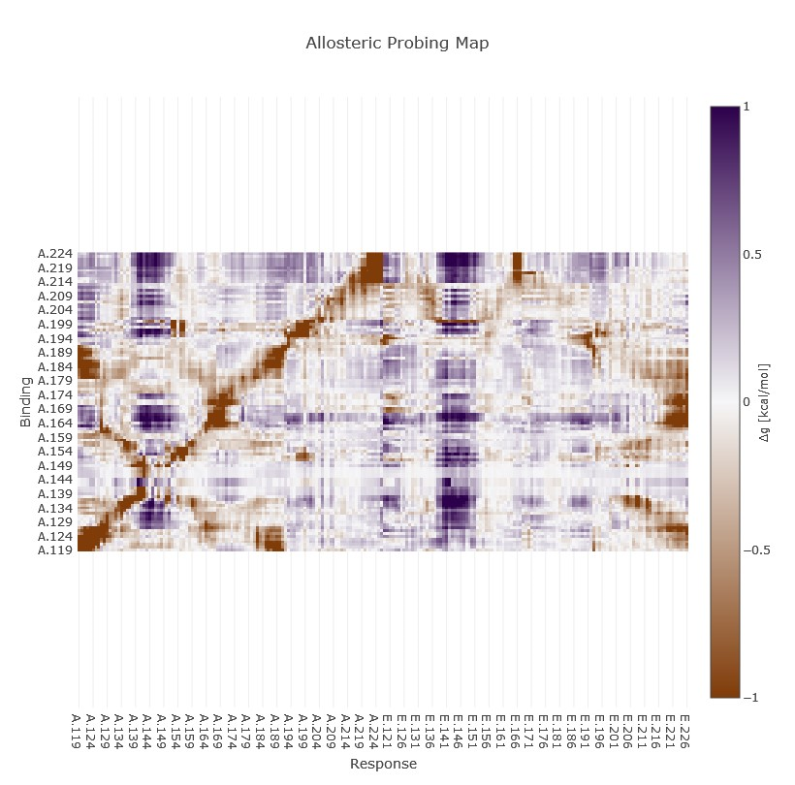
Testing regulatory sites (AlloSigMA)
Notes:
AlloSigMA was used to test the potential regulatory sites from ProteinLens
ProteinLens does not predict whether a site acts as a positive or negative modulator, but the probing map generated from AlloSigMA allows us to predict what will happen when something binds to different sites on the protein

Slide 20
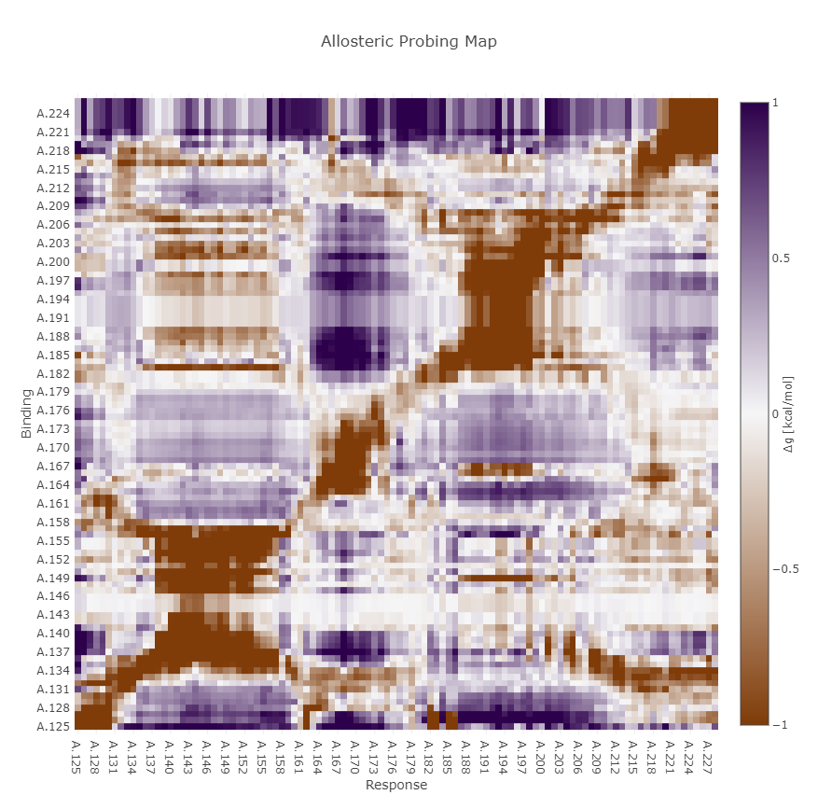
AllosigMA Predicts conformational changes in response to probe binding
Δg_{i} > 0 → positive allosteric modulator
Δg_{i} < 0 → negative allosteric modulator
Negative Δg_{i} indicates potentially stabilizing effect
Notes:
AlloSigMA gives an allosteric free energy change value (dg_i) for each residue in response to probe binding on a targeted residue
Positive allosteric free energy change indicates enhanced conformational changes upon binding or mutation (pos. allosteric modulator)
Neg. allosteric free energy change indicates suppressed conformational changes upon binding or mutation (neg. allosteric modulator)
Want to find sites where when probed, more rigidity is introduced in the region where misfold starts and the mutation sites tested – looking for a highly negative allosteric free energy change

Slide 21
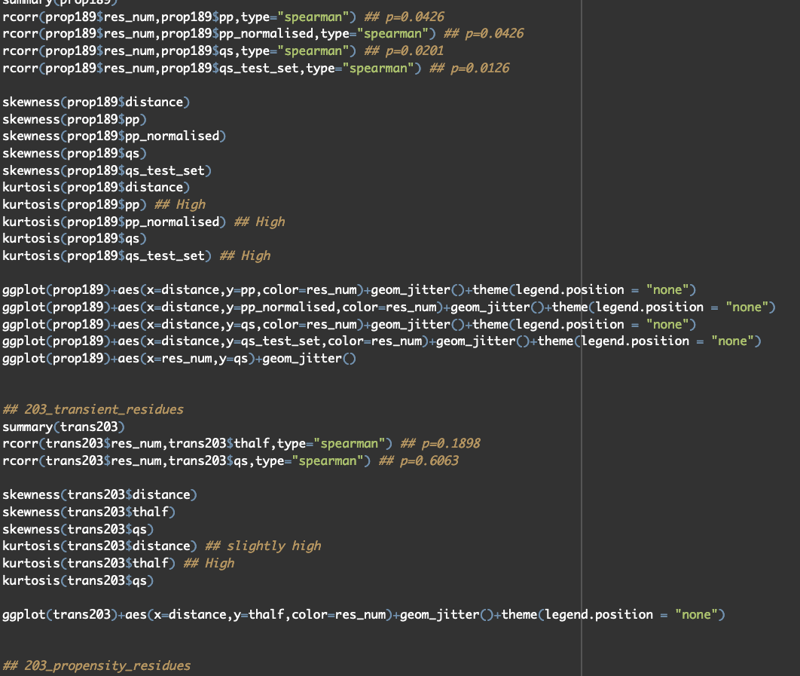
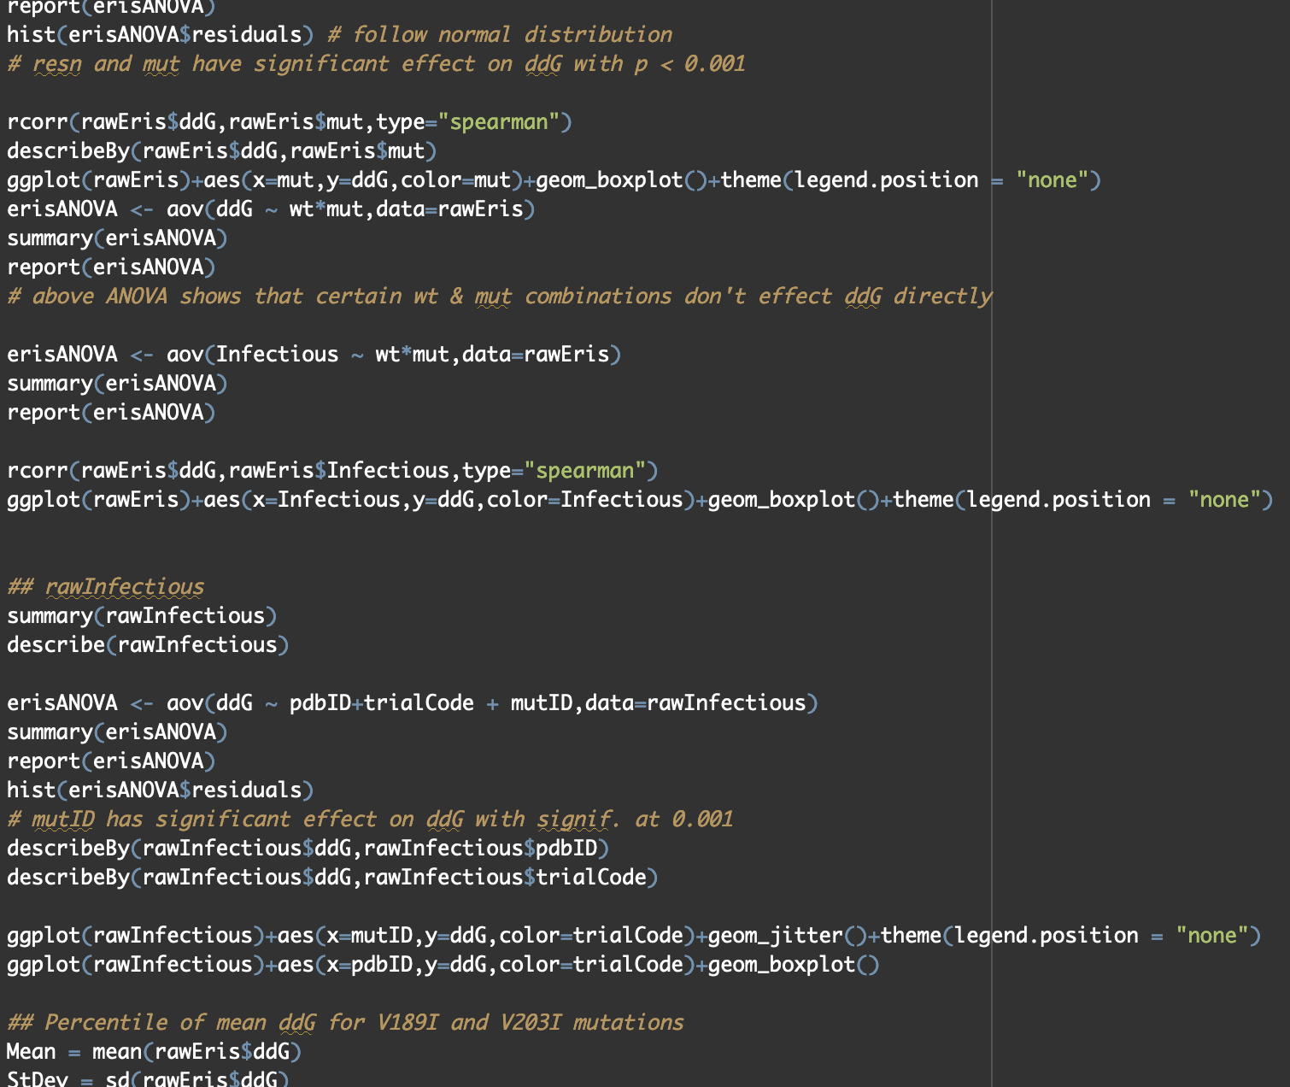
Data analysis & Verification of Methods
Notes:
H miscellaneous and ggplot packages used in R to run simple correlation calculations and produce graphs
Python used to write small scripts to help organize my data and track the hours I worked
QR code at end of presentation

Slide 22
Agenda
Background
Computational Methods
Data and Results
Discussion
Next Steps

Slide 23
V189I and V203I identified as mutations of interest
Mutation | ΔΔG Values
 | 1QM2 Trial 4 | Trial 4 with M129V
V189I | 2.89 | 4.87
V203I | 1.58 | 3.06
Notes:
No significant difference was found between the ddG distribution of mutations listed on HGMD and those not listed, this is consistent with previous work
Likely due to prion protein folding under kinetic control
Wanted to find mutations that were highly destabilizing and had multiple case studies reported – concluded with valine to isoleucine mutations at residues 189 and 203

Slide 24
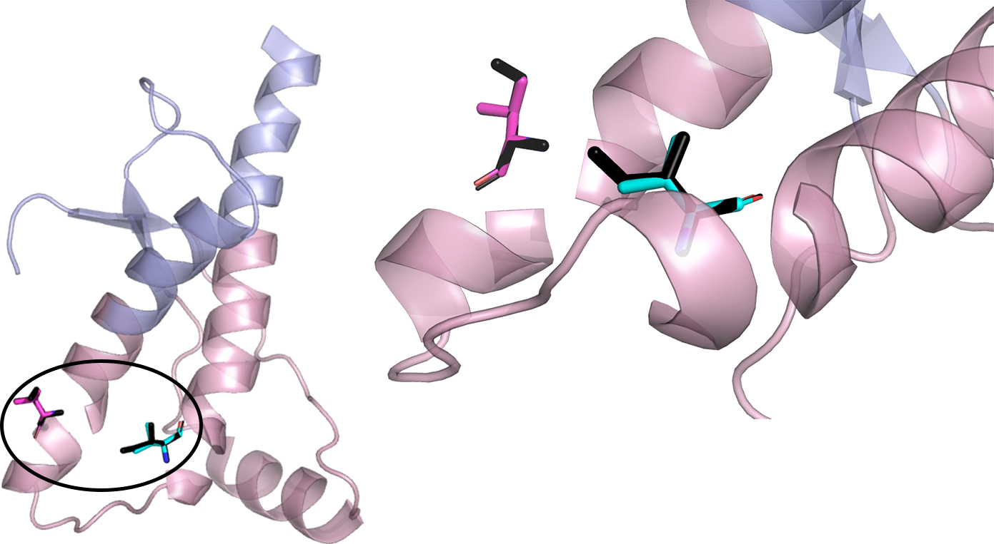
Notes:
Residue 189 in magenta
Residue 203 in cyan
Both mutations cause the same form of sporadic Creutzfeldt-Jakob disease (CJD)
MM1/MV1 variant – can be heterozygous for polymorphic mutation M129V (polymorphic mutation observed throughout research, but no solid conclusions could be made about how it might affect the usage of pharmacological chaperones)
These two residues were then used to generate a Markov transient plot with proteinlens to quantitate residue connectivity

Slide 25
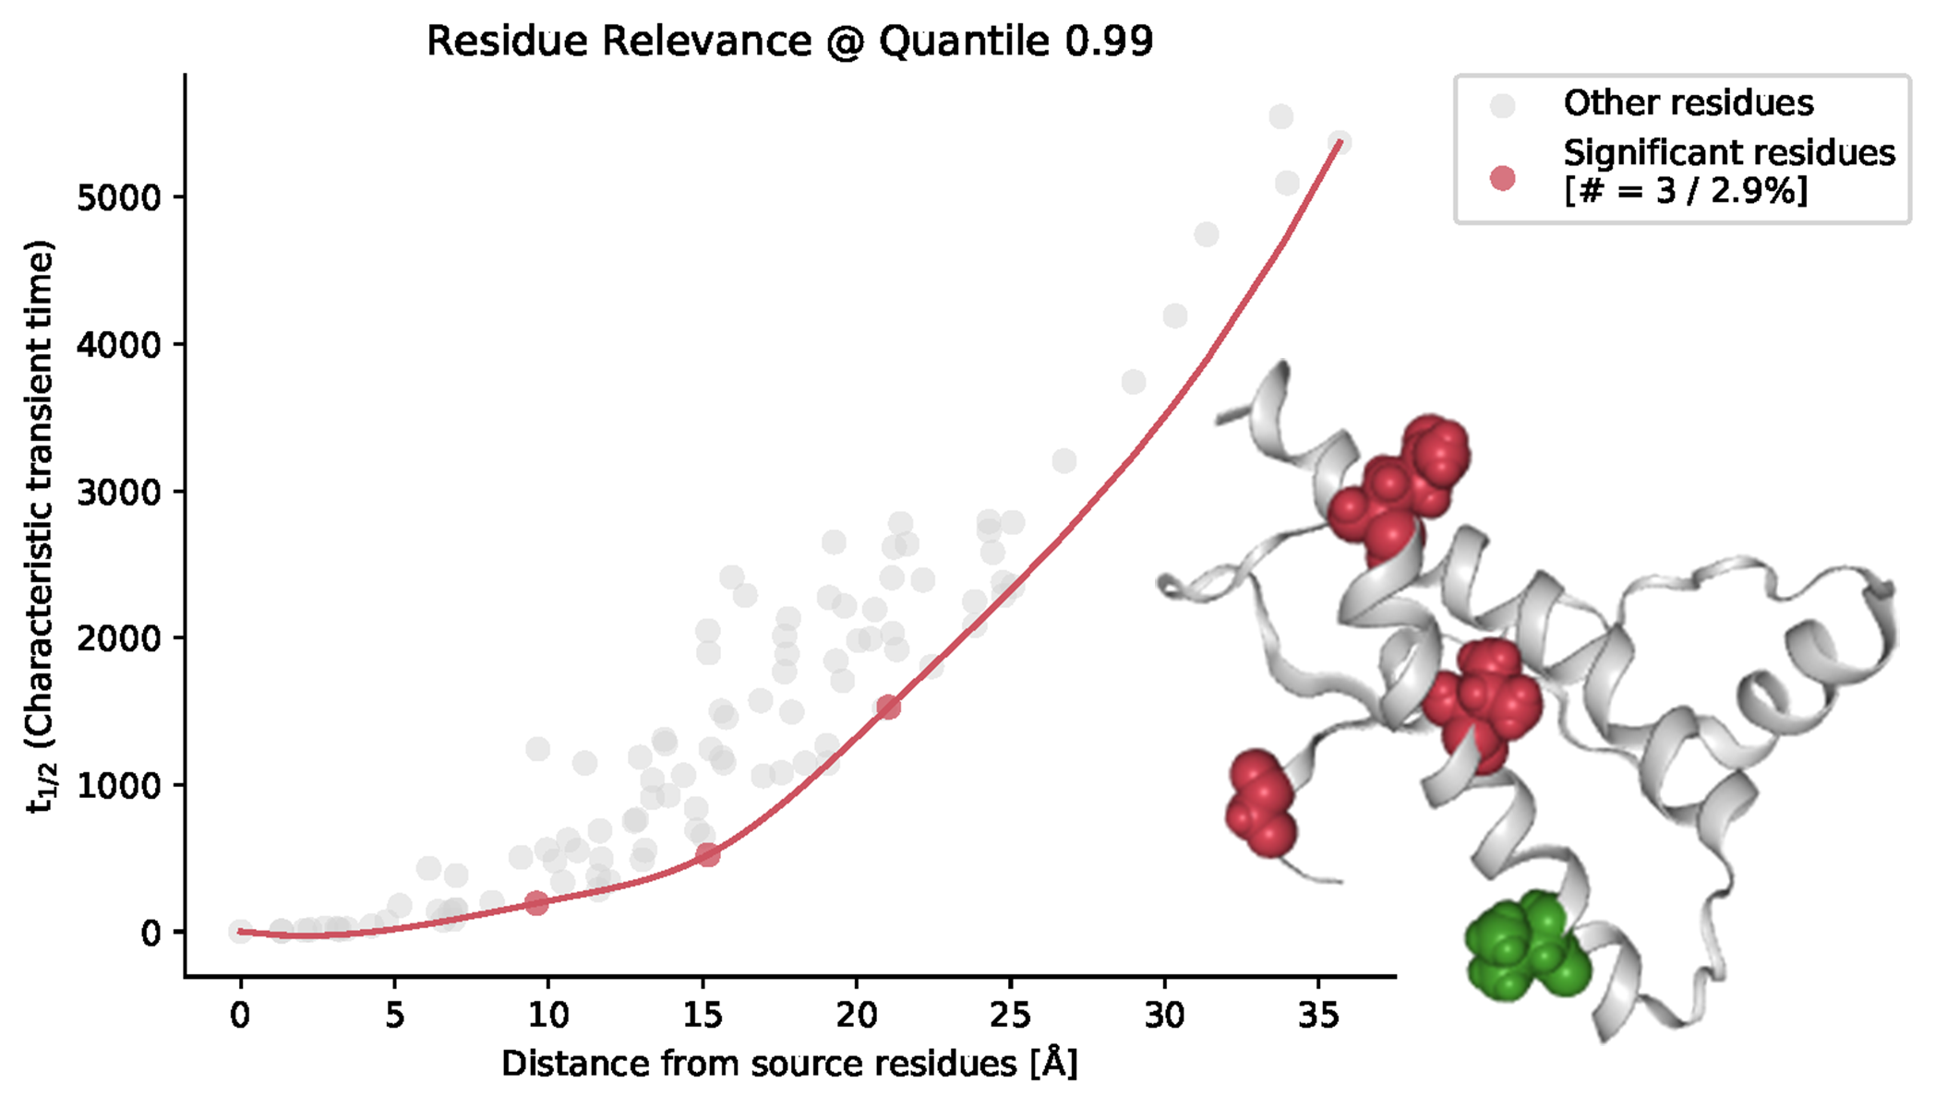
Markov transient plot with v189 designated as source site
Q172
G127
V180
Notes:
On the left is the Markov Transient Plot scoring residue relevance with residue 189 as the source site.
On the right, we see V189 in green, and three significant residues in red. These residues are Valine 180, Glycine 127, and Glutamine 172.

Slide 26
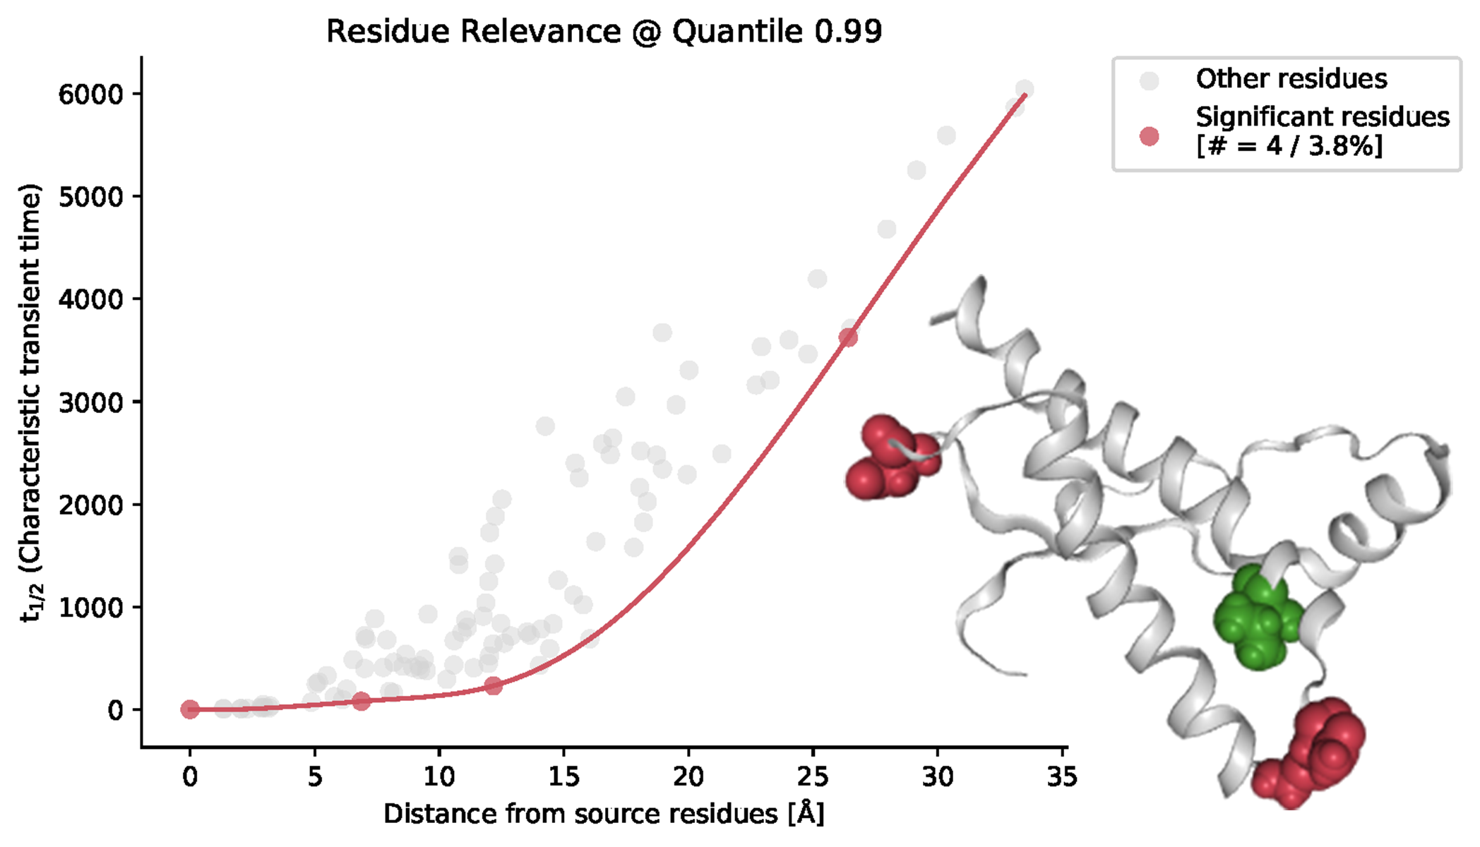
Markov transient plot with V203 designated as source site
D167
G195
N197
Notes:
On the left is the Markov Transient Plot scoring residue relevance with residue 203 as the source site.
On the right, we see V203 in green, and three significant residues in red. These residues are Asparagine 197, Glycine 195, and Aspartic Acid 167.
The residues outlined in the Markov Transient Plots were used to focus probe binding with AlloSigMA.

Slide 27
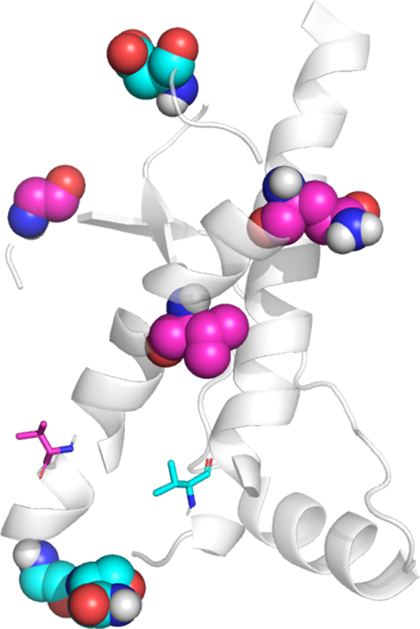
Mutations of interest may be regulated by residues in the same region of PrP^{C}
Source (Mutation) Site | Potential Regulatory Site | Characteristic Transient Time (t1/2) | Distance from Source Site (Å)
V189 | V180 | 193.75 | 9.61
 | G127 | 523.29 | 15.18
 | Q172 | 1529.12 | 21.05
V203 | N197 | 79.86 | 6.87
 | G195 | 230.86 | 12.17
 | D167 | 3623.75 | 26.41
R. M. Womack
27

Slide 28
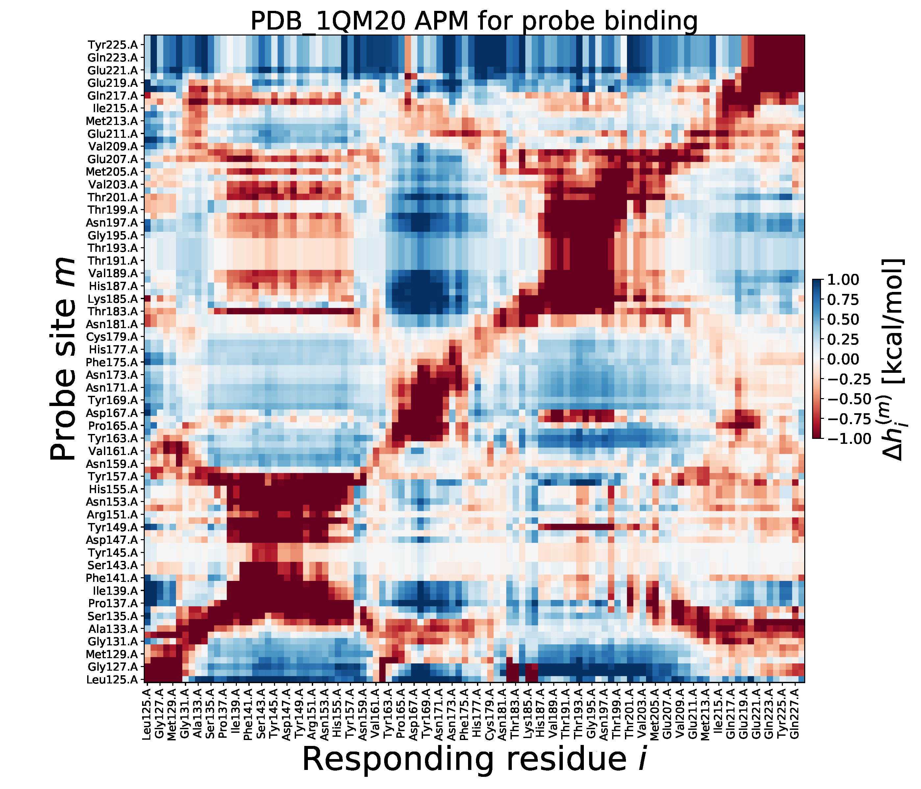
Simulated probe binding reveals potential regulatory sites
Notes:
Finally: test potential regulatory sites to find what sites add rigidity to misfold initiation site

Slide 29
Notes:
Yellow bars show how α2-α3 loop responds to probe binding on any residue in protein
Binding to res 194-199 has constraining effect on res 194-199
So does binding to res 166 & 167
And binding to res 149

Slide 30
Agenda
Background
Computational Methods
Data and Results
Discussion
Next Steps

Slide 31
Proposed binding sites for pharmacological chaperones
V189 shown in magenta, V203 in cyan
Site A: Residues 166 and 167 (green)
Site B: Residues 149, 195, and 197 (yellow)
Notes:
From previous work, binding to a site on each subdomain may help protein fold to native conformation
I propose 2 binding sites that could be bound by drug molecule to prevent misfold:
Site A: res 166 and/or 167
Site B: res 149, 195, 197

Slide 32
Agenda
Background
Computational Methods
Data and Results
Discussion
Next Steps

Slide 33
Moving forward
Replicating results with other mammalian prion protein structures
Identifying drug molecule characteristics through docking simulations
Simulating and analyzing prion-resistant mutations
Building machine-learning algorithm to identify, test, and conclude best allosteric sites on proteins

Slide 34

Thank you
Reagan McNeill Womack
reagan.womack@my.lr.edu
reagan.womack@outlook.com

